Slide 1
Rationale
Databases are an integral part of an organization. Aspiring Database Developers should be able to efficiently design and implement databases.
Knowledge of these will enable the developers to build robust database solutions.
This module will help students understand concepts related to relational databases.
Notes:
Student already have learnt about SCDs in Module I. Therefore, you can start this topic by asking the following questions to students:
What are type 1 SCDs?
Given an example to explain type 1 SCDs.
This will recapitulate what they have learnt about type 1 SCD in Module 1.
Now explain the strategy to load the data into these dimension tables with help of the given diagram. Relate this diagram to the example given in SG.

Slide 2
Objectives
In this session, you will learn to:
Define a Database Management System
Describe the types of data models
Create an entity-relationship model
List the types of relationships between entities
Define a Relational Database Management System
Describe the operators that work on relations
Notes:
Students have learnt the structure of different types of dimensions and the importance of surrogate keys in Module I. In this session, students will learn to load the data into the dimension tables after the data has been transformed in the transformation phase. In addition, students will also learn to update data into these dimension tables.
Students already know about different types of dimension tables. Therefore, you can start the session by recapitulating the concepts. Initiate the class by asking the following questions:
1. What are the different types of dimensions?
2. Define flat dimension.
3. What are conformed dimension?
4. Define large dimension.
5. Define small dimension.
6. What is the importance of surrogate key in a dimension table?
Students will learn the loading and update strategies theoretically in this session. The demonstration to load and update the data in the dimension table will be covered in next session.

Slide 3
Database Management Systems
A database is a collection of logically related information.
Database Management is the task of maintaining databases so that information is readily available.
The software required to perform the task of database management is called a Database Management System (DBMS).
Notes:
Students know the importance of surrogate keys. In this session students will learn the strategy to generate the surrogate key. Give an example to explain the strategy to generate the surrogate keys by concatenating the primary key of the source table with the date stamp. For example, data from a Product table has to be loaded into the Product_Dim dimension table on Feb 09, 2006. The product_code is the primary key column in the Product table. To insert the surrogate key values before loading the data into the dimension table, you can combine the primary key value with the date on which the data has to be loaded. In this case the surrogate key value can be product_code+09022006.

Slide 4
DRELATIONAL MODEL
Can be classified into two categories:
Object-based logical model focuses on describing the data, the relationship among the data, and any constraints defined
Record-based logical model focuses on describing the data structure and the access techniques in the DBMS
Notes:
Students know what is the structure of Flat dimension. You can initiate the session by asking the following questions:
1. What are flat dimension tables?
2. What is the structure of flat dimension?
3. Given examples of a flat dimension?
Next, tell the strategy to load the data into the flat dimension table. You can explain the loading strategy with the help of the example given in SG.
Continue this session by asking the following questions:
4. What are large flat dimension tables?
5. Give examples of large flat dimensions?
Then, explain the strategy to load data into the large flat dimension table.
Before explaining the strategy to load data into the small dimension table ask the following questions and the tell the strategy to load the data into the dimension table.
6. What are small flat dimension tables?
7. Give examples of small flat dimension tables.
With the help of these questions, students will be able to recall about flat dimensions, they have learnt in Module I.
Explain this topic with the help of an example given in SG.

Slide 5
Object-Based Logical Model
There are various object-based models. The most widely used is the Entity-Relationship model (ER model) introduced by Peter Chen.
Notes:
Explain the strategy to load the data into conformed dimension with help of an example to load the data in the date dimension given in SG.
Explain the strategy to load the data into the Snowflaked dimension with the help of an example given in SG.

Slide 6
Entities
Chen defined an entity as “a thing, which can be easily identified”.
An entity is any object, place, person, or activity about which data is recorded.
In the diagramming technique, entities are named and represented inside a box.
An entity type is a set of things that share common properties:
STUDENT, COURSE, and GRADE are examples of entity type.
An entity type is usually in uppercase.
Notes:
Explain the strategy to load the data into conformed dimension with help of an example to load the data in the date dimension given in SG.
Explain the strategy to load the data into the Snowflaked dimension with the help of an example given in SG.

Slide 7
Entities (Contd.)
Types of Entities:
Dependent entity: Weak entity
Is an entity whose existence depends on the existence of another entity and are also called weak entities
Independent entity: regular
Is an entity which does not depend on any other entity for existence and are also called regular entities
Notes:
Explain the strategy to load the data into conformed dimension with help of an example to load the data in the date dimension given in SG.
Explain the strategy to load the data into the Snowflaked dimension with the help of an example given in SG.

Slide 8
Relationships
Chen defines a relationship as “an association among entities”.
For example, the relationship between students and instructors represents the fact that an instructor teaches several students and a student is taught by several instructors. This relationship could be named TEACH.
Relationships are depicted as a diamond with the name of the relationship type.
Notes:
Explain the strategy to load the data into conformed dimension with help of an example to load the data in the date dimension given in SG.
Explain the strategy to load the data into the Snowflaked dimension with the help of an example given in SG.

Slide 9
Relationships (Contd.)
A relationship type is an association of entity types (STUDENT-INSTRUCTOR).
A relationship can associate an entity with itself. For example, one instructor in a university may marry another instructor.
Multiple relationships can also exist between the same entities.
Notes:
Explain the strategy to load the data into conformed dimension with help of an example to load the data in the date dimension given in SG.
Explain the strategy to load the data into the Snowflaked dimension with the help of an example given in SG.

Slide 10
Just a minute
The following statement has been extracted from a case presented by a manufacturer regarding the maintenance of their data: “A supplier ships certain parts.” Identify the entities mentioned in this statement, and their relationship. Draw a diagram depicting the relationship.

Slide 11
Just a minute (Contd.)
Answer:
Entities: SUPPLIER, PARTS
Relationship: SHIP (or SHIPMENT)
SUPPLIERS
SHIP
PARTS

Slide 12
Types of Relationships
There are three types of relationships:
One-to-One
One-to-Many (or Many-to-One)
Many-to-Many
Notes:
Student already have learnt about SCDs in Module I. Therefore, you can start this topic by asking the following questions to students:
What are type 1 SCDs?
Given an example to explain type 1 SCDs.
This will recapitulate what they have learnt about type 1 SCD in Module 1.
Now explain the strategy to load the data into these dimension tables with help of the given diagram. Relate this diagram to the example given in SG.

Slide 13
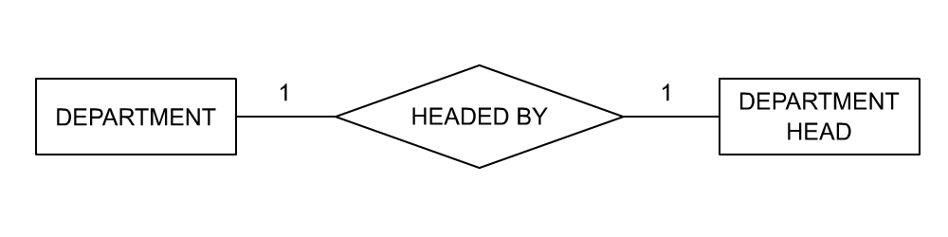
One-to-One Relationship
Consider the example of a university. For one DEPARTMENT (like the department of social sciences) there can be only one department head. This is a one-to-one relationship.
Notes:
Student already have learnt about type 2 SCDs in Module I. Therefore, you can start this topic by asking the following questions to students:
What are type 2 SCDs?
Given an example to explain type 2 SCDs.
This will recapitulate what they have learnt about type 2 SCD in Module 1.
Now explain the strategy to update the data into these dimension tables with help the example given in SG.
After explaining the examples, you can ask students to think of an example of a type 2 SCD and then tell the strategy to update the data into this dimension table.

Slide 14
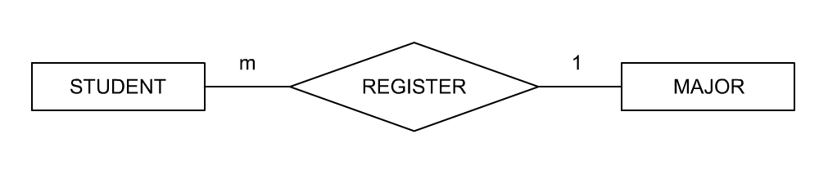
Many-to-One Relationship
A STUDENT can MAJOR in only one course, but many STUDENTs would have registered for a given MAJOR course. This is a many-to-one relationship.
Notes:
Student already have learnt about type 2 SCDs in Module I. Therefore, you can start this topic by asking the following questions to students:
What are type 2 SCDs?
Given an example to explain type 2 SCDs.
This will recapitulate what they have learnt about type 2 SCD in Module 1.
Now explain the strategy to update the data into these dimension tables with help the example given in SG.
After explaining the examples, you can ask students to think of an example of a type 2 SCD and then tell the strategy to update the data into this dimension table.

Slide 15
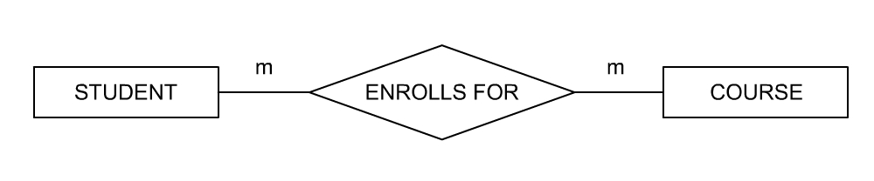
Many-to-Many Relationship
A STUDENT can take many COURSEs and many STUDENTs can register for a given COURSE. This is a many-to-many relationship.
Notes:
Student already have learnt about type 2 SCDs in Module I. Therefore, you can start this topic by asking the following questions to students:
What are type 2 SCDs?
Given an example to explain type 2 SCDs.
This will recapitulate what they have learnt about type 2 SCD in Module 1.
Now explain the strategy to update the data into these dimension tables with help the example given in SG.
After explaining the examples, you can ask students to think of an example of a type 2 SCD and then tell the strategy to update the data into this dimension table.

Slide 16
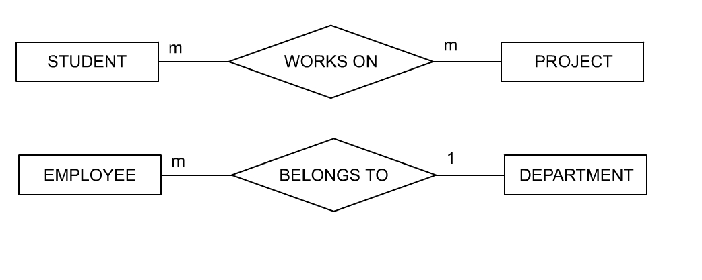
Just a minute
What do the following ER diagrams represent?

Slide 17
Just a minute (Contd.)
Answer:
Many students can work on many projects.
Many employees belong to only one department.

Slide 18
Just a minute
Consider the following statement of a manufacturing company:
“A supplier ships certain parts. A particular part is not necessarily shipped by only one supplier. No supplier ships only a single part.”
What type of relationship is this? Draw a diagram to depict the relationship.
Answer:
Many-to-many type
SUPPLIER
m
m
SHIP
PARTS

Slide 19
Attributes
Attributes are a property of a given entity.
Attributes are depicted as ellipses, labeled with the name of the property.
Notes:
Student already have learnt about type 3 SCDs in Module I. Therefore, you can start this topic by asking the following questions to students:
What are type 3 SCDs?
Given an example to explain type 3 SCDs.
This will recapitulate what they have learnt about type 3 SCD in Module 1.
Now explain the strategy to update the data into these dimension tables with help the example given in SG.
After explaining the examples, you can ask students to think of an example of a type 3 SCD and then tell the strategy to update the data into this dimension table.
You can now ask the student to explain the difference between the update strategy for all the three SCDs.
You can also ask students to think of a scenario where you have a type 3 SCD and then ask them how to update the data in such dimension tabels.
Also tell student that they will learn to load data into these dimension table using SSIS.

Slide 20
Just a minute
A manufacturer needs to maintain the following details about the supplier:
a. Name
b. Address
c. Credit Status
d. Assigned code number -id
Draw a diagram to show this information.

Slide 21
Just a minute (Contd.)
Answer:
CODE
NAME
SUPPLIER
ADD
CR_STATUS

Slide 22
Subtypes and Supertypes
Subtype:
Is a subset of another entity. It is always dependent on the supertype for its existence
Is connected to the supertype by an unnamed relationship
Supertype:
Is connected to the relationship with a line containing a crossbar
Is described by attributes that belong to all subtypes. The subtype is described by the attributes that are unique to it

Slide 23
Just a minute
There are two types of suppliers. One type of supplier allows credit, while the other type insists on payment in cash before delivery. The manufacturer wishes to maintain separate information on these two types of suppliers. For the credit supplier, “credit period” and “credit limit” have to be recorded. For the cash supplier, “date of payment” has to be stored. Represent this diagrammatically.
Answer:
SUPPLIERS
CASH
CREDIT
PAY_DT
CR_LIMIT
CR_PERIOD

Slide 24
Record-Based Logical Model
The three types of record-based models are:
Hierarchical model
In a hierarchical model, data is represented in the form of a tree.
Network model
A network model is similar to a hierarchical model in the way that data and the relationships among them are represented in the form of records and links.
Relational model
In the relational model, the database is structured in fixed-format records of several types.
Notes:
Student already have learnt about SCDs in Module I. Therefore, you can start this topic by asking the following questions to students:
What are type 1 SCDs?
Given an example to explain type 1 SCDs.
This will recapitulate what they have learnt about type 1 SCD in Module 1.
Now explain the strategy to load the data into these dimension tables with help of the given diagram. Relate this diagram to the example given in SG.

Slide 25
Relational Model
Dr. E. F. Codd first described the relational model in 1970.
Relational model is an attempt to simplify the database structure.
It represents all data in the database as simple tables in the row-column format.
RDBMS can be defined as a DBMS where all data visible to the user is organized strictly as tables of data values and where all database operations work on these tables.
Notes:
Student already have learnt about SCDs in Module I. Therefore, you can start this topic by asking the following questions to students:
What are type 1 SCDs?
Given an example to explain type 1 SCDs.
This will recapitulate what they have learnt about type 1 SCD in Module 1.
Now explain the strategy to load the data into these dimension tables with help of the given diagram. Relate this diagram to the example given in SG.

Slide 26
Relational Data Structure
The organizing principle in a relational database is the table, a tabular arrangement of data values:
A table is called a relation.
The row (or record) in the table is called a tuple.
The column (or field) is called an attribute.
The number of tuples is called the cardinality, and the number of attributes is called the degree of the table.
Rows are unordered and each row must have some columns or a combination of columns that uniquely identifies each row, called the primary key of the table.
A domain is a pool of values from which one or more attributes (columns) draw their actual values.
Notes:
Student already have learnt about SCDs in Module I. Therefore, you can start this topic by asking the following questions to students:
What are type 1 SCDs?
Given an example to explain type 1 SCDs.
This will recapitulate what they have learnt about type 1 SCD in Module 1.
Now explain the strategy to load the data into these dimension tables with help of the given diagram. Relate this diagram to the example given in SG.

Slide 27
Representing Missing Information
Missing or unknown information is represented as NULL in a relational system:
NULL is not the same as space or zero.
Notes:
Student already have learnt about SCDs in Module I. Therefore, you can start this topic by asking the following questions to students:
What are type 1 SCDs?
Given an example to explain type 1 SCDs.
This will recapitulate what they have learnt about type 1 SCD in Module 1.
Now explain the strategy to load the data into these dimension tables with help of the given diagram. Relate this diagram to the example given in SG.

Slide 28
Representing Relationships in an RDBMS
At any given time, no two rows of the table contain the same values in a column or column combination. This column (or columns) is called the primary key of the table.
A column in one table whose value matches the primary key in some other table is called a foreign key
Together, a primary key and a foreign key create a parent-child relationship between the tables that connects them
Notes:
Student already have learnt about SCDs in Module I. Therefore, you can start this topic by asking the following questions to students:
What are type 1 SCDs?
Given an example to explain type 1 SCDs.
This will recapitulate what they have learnt about type 1 SCD in Module 1.
Now explain the strategy to load the data into these dimension tables with help of the given diagram. Relate this diagram to the example given in SG.

Slide 29
Relational Operators
The relational model is based on the principle of relational algebra:
It is a collection of operators operating on relations.
Each operator takes one or two relations as its input and produces a new relation as its output.
Relational Operators are of the following types:
RESTRICT: Extracts specified tuples or rows from a given relation, based on a condition.(where clause—limited rows)
PROJECT: Extracts specified attributes or columns from a given relation.(retrieving selected columns)
PRODUCT: Builds a relation from two specified relations. It consists of all possible combinations of tuples, one from each of the two relations.(all possible combinations of rows of all tables)—CROSS JOIN.
Notes:
Student already have learnt about SCDs in Module I. Therefore, you can start this topic by asking the following questions to students:
What are type 1 SCDs?
Given an example to explain type 1 SCDs.
This will recapitulate what they have learnt about type 1 SCD in Module 1.
Now explain the strategy to load the data into these dimension tables with help of the given diagram. Relate this diagram to the example given in SG.

Slide 30
Relational Operators (Contd.)
UNION: Builds a relation from tuples appearing in either or both of the specified relations. To be union compatible, the two tables should have the same types of attributes.
INTERSECT: Builds a relation consisting of tuples that appear in both relations.
DIFFERENCE: Builds a relation of tuples appearing in the first but not the second of two specified relations.
JOIN: Builds a relation from two specified relations which consists of all possible combinations of tuples, one from each relation, that satisfy the specified condition.
DIVIDE: The Divide operator takes two relations and builds another relation consisting of values of an attribute of one relation that match all the values in the other relation.
Notes:
Student already have learnt about SCDs in Module I. Therefore, you can start this topic by asking the following questions to students:
What are type 1 SCDs?
Given an example to explain type 1 SCDs.
This will recapitulate what they have learnt about type 1 SCD in Module 1.
Now explain the strategy to load the data into these dimension tables with help of the given diagram. Relate this diagram to the example given in SG.

Slide 31
Applications of an RDBMS
Some typical applications of an RDBMS are:
Airline and railway reservations
Banking applications
Manufacturing industry
Order processing
Hospital management systems
Library management systems
Hotel industry
Notes:
Student already have learnt about SCDs in Module I. Therefore, you can start this topic by asking the following questions to students:
What are type 1 SCDs?
Given an example to explain type 1 SCDs.
This will recapitulate what they have learnt about type 1 SCD in Module 1.
Now explain the strategy to load the data into these dimension tables with help of the given diagram. Relate this diagram to the example given in SG.

Slide 32
Applications of an RDBMS (Contd.)
Several RDBMS products are available today. Some popular products are:
Sybase
Oracle
Microsoft SQL Server
Ingress
DB2
Only ui is changed.
Notes:
Student already have learnt about SCDs in Module I. Therefore, you can start this topic by asking the following questions to students:
What are type 1 SCDs?
Given an example to explain type 1 SCDs.
This will recapitulate what they have learnt about type 1 SCD in Module 1.
Now explain the strategy to load the data into these dimension tables with help of the given diagram. Relate this diagram to the example given in SG.

Slide 33
Summary
In this session, you learned that:
Data models can be classified as:
Object-based models
Record-based models
In the entity-relationship diagramming technique:
Entities are represented as rectangles.
Relationships are represented as diamonds.
Attributes are represented as ellipses.
Relationships, whether many-to-many, one-to-many, or one-to-one, are represented symbolically.
Weak entities are represented in double-lined boxes.
Subtypes are connected to the supertype by an unnamed relationship, marked with a crossbar on top.
Notes:
You can summarize the session by running through the summary given in SG.
In addition, you can also ask students summarize what they have learnt in this session.

Slide 34
Summary (Contd.)
In the relational model, data is represented in tables (relations) of rows (tuples) and columns (attributes).
The number of tuples is called the cardinality of the relation, and the number of attributes is called the degree of the relation.
An attribute (or set of attributes) that is unique in every tuple is called the primary key.
Unknown or missing information is represented by a NULL in a table.
The foreign key is a column in one table that matches the primary key of another table.
The relational model is based on the principle of relational algebra.
The eight operators that operate on relations are restrict, project, product, union, intersect, difference, join, and divide.
Notes:
You can summarize the session by running through the summary given in SG.
In addition, you can also ask students summarize what they have learnt in this session.

